Slide 1
The Metrics and Measures of Trending YouTube Videos
By Like Follow and Subscribe (Robert Powell, KJ Nguyen and Xinran Shi)

Slide 2
Project goal
Finding what aspect of a video (channel, category, title, etc) has the greatest impact on a video trending.
Which categories of the video attract viewers most?
What kind of titles attract viewers?
When the videos should be launched?

Slide 3
Business context
By knowing what type of category of the video, how long it is,..etc the company may decide which type of video of promotion they use. Which kind of channel should be developed, what kind of tags should be included in order to attract more viewers.
A multimedia which does online business, or some Youtubers have income from Youtube may need to know which Categories likely to attract viewers the most

Slide 4
Research Questions
How does category affect trending status?
What were the top 5 channels in likes, views, and like:dislike ratios?
Does the publishing time affect the success of the video?
How likes and dislikes are related?
How does trending date affect the success of video?
How does title affect the video?

Slide 5
Data Description
The source of Trending YouTube Video Statistics dataset is kaggle.com.
The dataset is collected by YouTube to determine the year’s top trending videos.
There are 4 different data tables, two of them are category id, which varies between regions and has 44 elements.
The other two data tables includes the video title, channel title, publish time, tags, views, likes and dislikes, description, and comment count.
These two data tables, each corresponding to the US and Canada, include around 40,600 records, with about 24,000 unique videos.
These data can help us to draw the correlation table and find the data that is highly correlated to the top trending.

Slide 6
Methodologies
Remove 48 video that is duplicate
the specific data columns that are removed from the data set
the specific data columns of which N/A or other invalid values are recorded or replaced: 23 videos from the dataset are deleted, since they are removed from YouTube.
There is a huge amount of data being collected from 2017 to 2018 causing them to be the outliers. But they are the data from the most recent two years and should be more accurate. So we decide to only look at data from those two years.
New columns: % of Likes, %of Likes (view), Number of days to become trending video =DateIF(F2,B2,”d”)
Likes,dislikes
% of Likes
= (J2/(J2+K2))
% of Likes of total views
= J2/I2
New File: US Category ID Title
Trending date (convert it to the date type)
= date(“20” &left(B2,2),right(B2,2),MID(B2,4,2))

Slide 7
Research Question #1
How does category affect trending status?
What percentage of the total videos is each category?
What are the top 3 categories in likes, views, and like-dislike ratio?
Is there time to trending difference for each category?
Did Category views change every month?

Slide 8
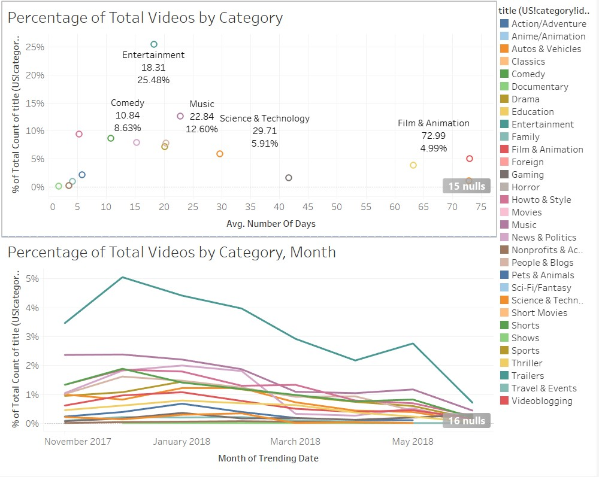
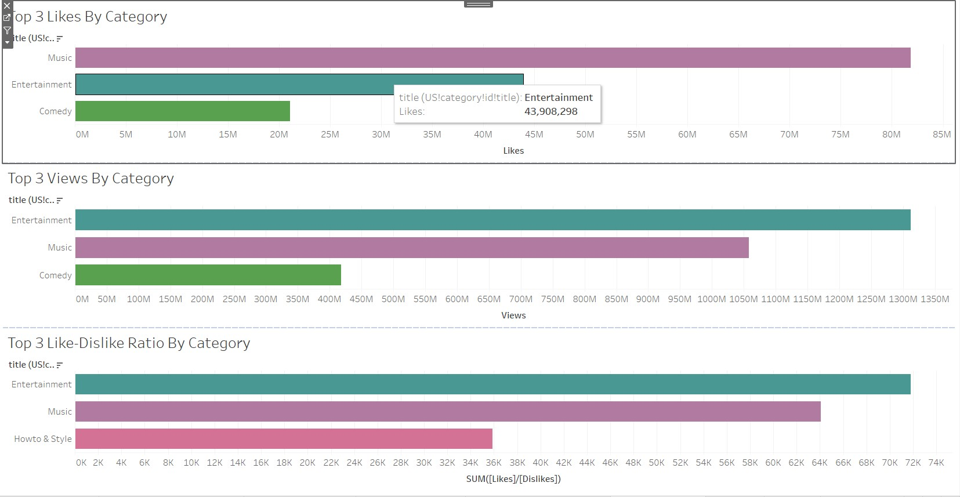
Analysis
Entertainment was easily the largest and most common category at 25%, music was the other big category at 12%
Both Entertainment and Music were the top 2 in all 3 metrics, in likes and views, Comedy was #3, in Like-Dislike it was How-To
Shows had an average of 1.75 days to trend, Film and Animation had an average of almost 73 days

Slide 9
Research Question #2:
What were the top 5 channels in likes, views, and like:dislike ratios?
Does the channel correlate with like, views and l:d ratio?
What channels had the shortest time to trend?
Did views for the top 5 channels change over time?

Slide 10
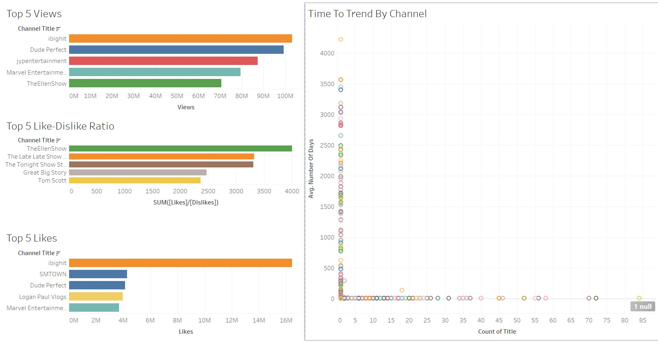
Analysis
Channels with most views were ibighit, Dude Perfect, jypentertainment, MarvelEntertainment and TheEllenShow. EllenShow also had the biggest like-dislike ratio, and Dude Perfect and ibighit both made the top 5 in likes
Average days to trending was difficult to show correlation, more than 20 channels listed a time of 0, but the video output varied greatly between them. Generally, channels with a long time to trend did not publish many videos
Views for the top 5 channels increased in different places, for example ibighit peaked in May, whereas Marvel peaked in December

Slide 11
Research Question #3
Does the publishing time affect the success of the video?
Which month has the most trending videos (Nov 2017 - June 2018)?
How long does it usually take a video to become a trending video
What time during the day did the video published?

Slide 12
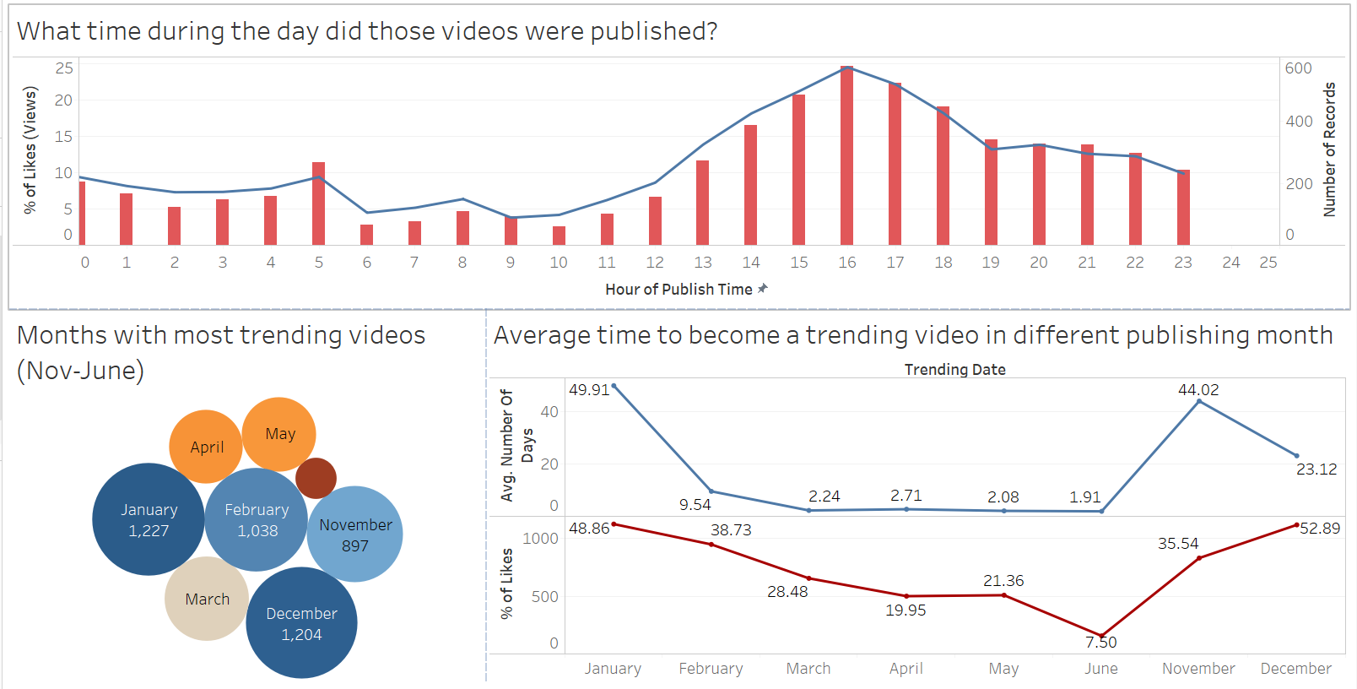
Analysis
It takes significantly more time for a video to become a trending video in November to January (over 23 days) but it only take about 2 days for a video to become trending in March - June
There are more trending videos in 4th Quarter and January
Most videos were published in the afternoon since it may attract more viewers

Slide 13
Research Question #4
How likes and dislikes are related. (like the portion or correlation)
Which title has the most likes?
Is there any correlation between dislikes and titles?
Like vs Dislikes on top 10 views channels
What publishing month has the most views and likes? (Nov 2017 - June 2018)

Slide 14
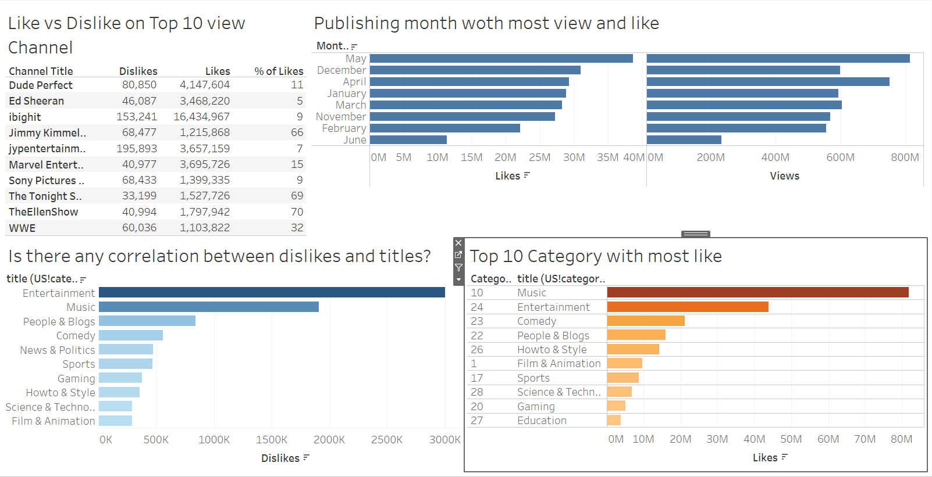
Analysis
Music has the most like among 24 categories
Music also has the most dislike in 24 categories
The most like channel is Ibighit with more than 16 millions likes
Videos published in May have most view and likes other month but June have over 500 millions views and 20 millions likes

Slide 15
Research Question #5
How does trending date affect the success of video?
Which month of the trending date has the most
number of comments and views?
Which month the trending date has the highest
percent of likes and dislikes?

Slide 16
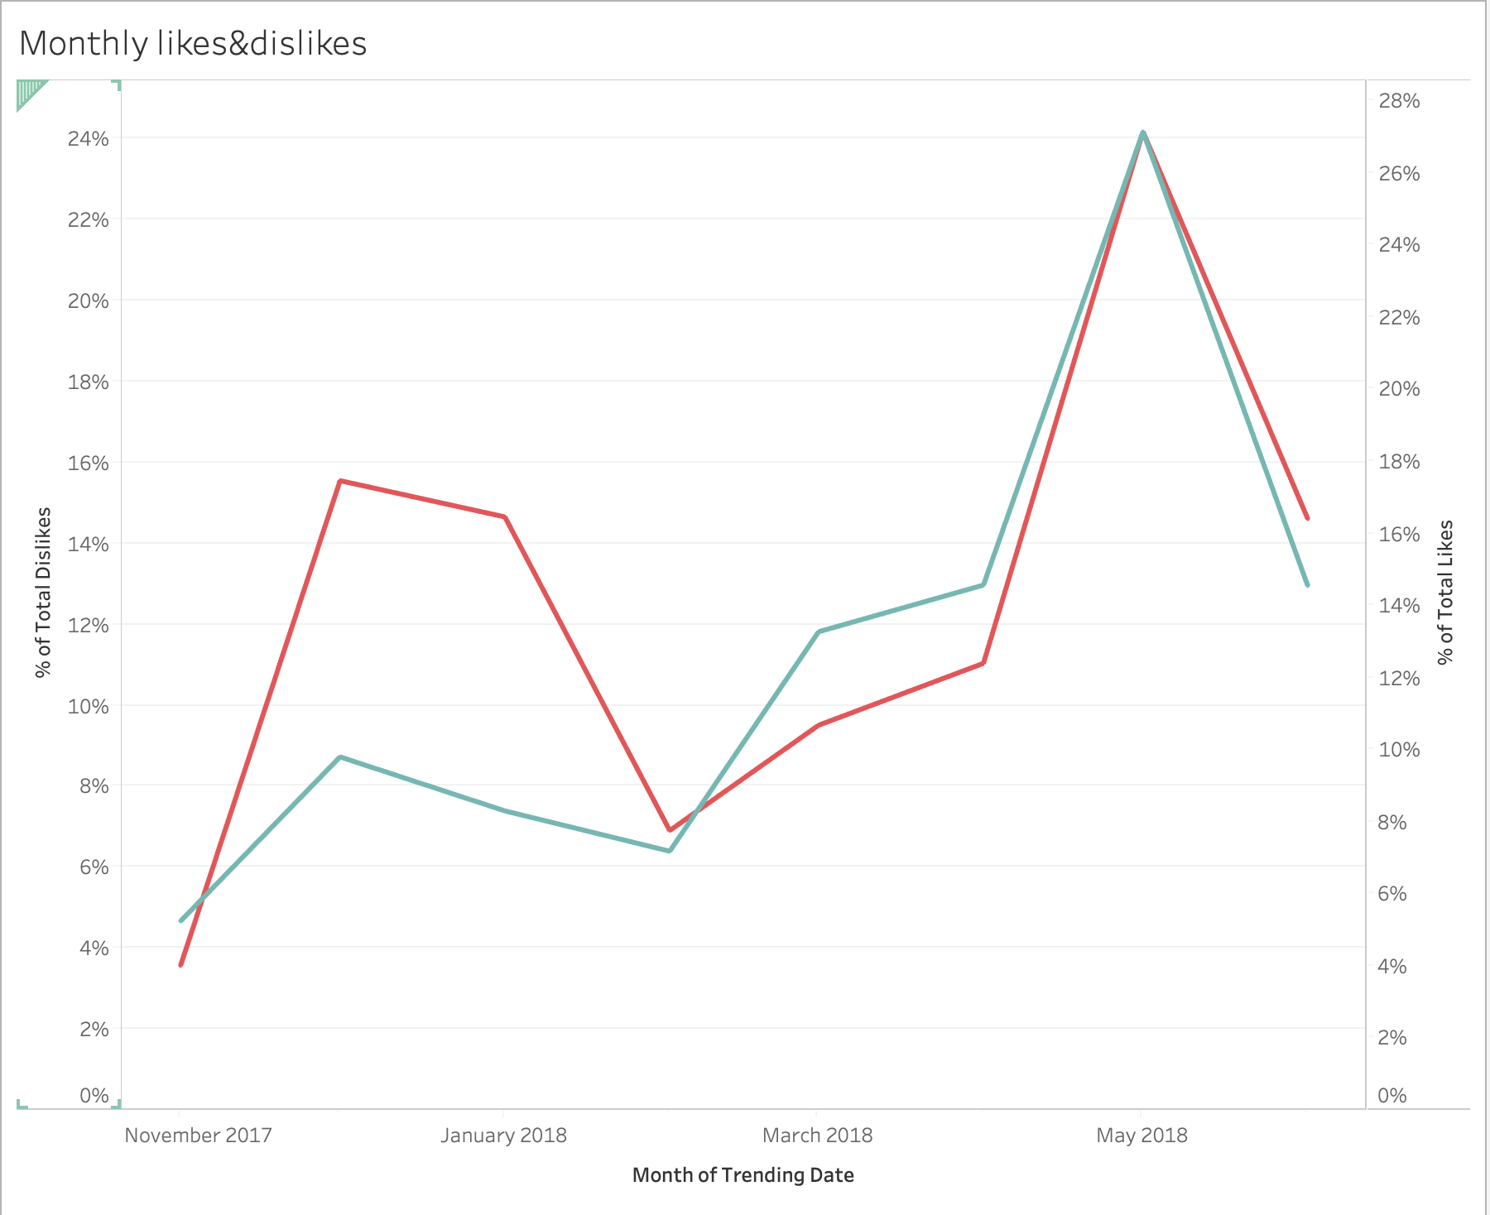
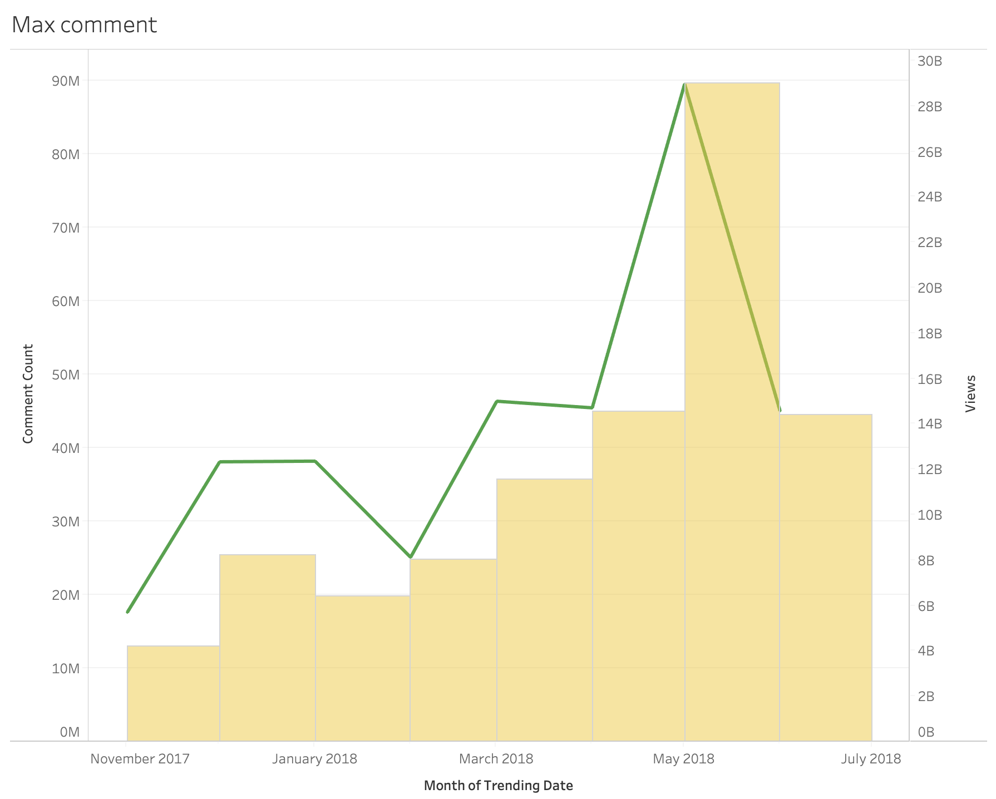
Analysis
May has the most number of views among all these months and it start to drop after it.
The comments number, likes and dislike rates have a similar trend and also associated with the number of views.
The number of views are changed dramatically in one year.
Publish the videos with higher qualities in May could be a good opportunity to success! Read the comments carefully to make changes to that. Do not too disturbed by the number of likes and dislikes. They are all correlated.

Slide 17
Research Question #6
How does title affect the video?
Top 10 titles?
Number of views affect on likes and dislikes

Slide 18
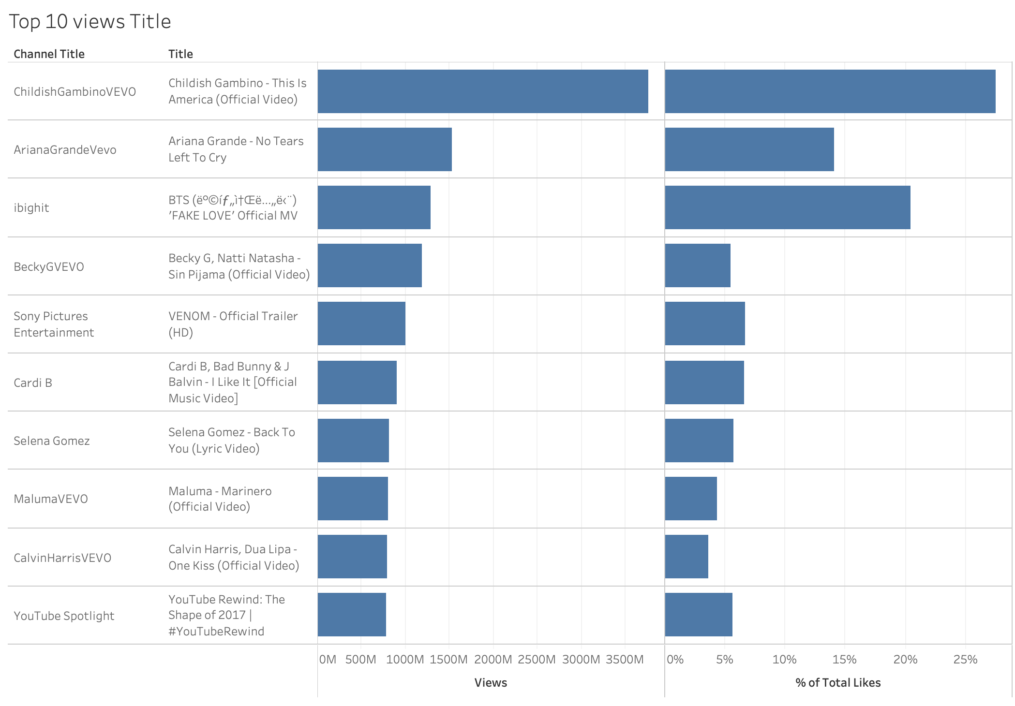
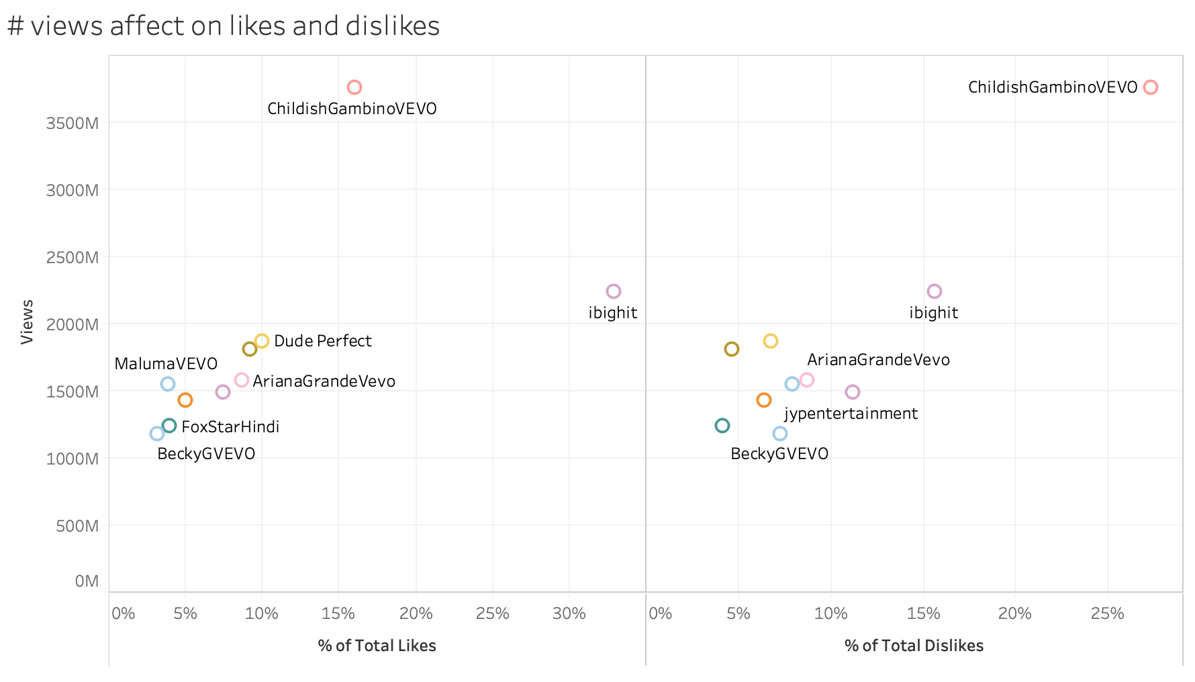
Analysis
Most of the views videos are official videos
Music videos are contributed a great portion on views.
Except for the Youtube Spotlight one ( which is a conclusion video), all of them are uploaded around May.
The likes and dislike rates are similar for each video
Official videos and music videos usually draws more eyes.

Slide 19
Limitations
Limited to the period of when the data was collected, which ended in late 2018
One questions had to be revised:
“Does channel title affect the video trending?” was simplified to look into the top 5 channels in several metrics
Coronavirus pandemic meant much of the project had to be done online, ie no in person meetings, besides just the general chaos of the past few months.
Did not know how to compare how titles correlated with disable like or comments.

Slide 20
Takeaways
Music and entertainment were the most popular categories
People tend to watch more videos in May
Youtubers tend to publish videos much often from November to February
Channels that published more frequently had a shorter time to trend
Many of the most popular channels were already established brands outside of YouTube.

Slide 21
Recommendation
Publishing videos with good quality in May gives you more opportunities to succeed
Entertainment is most popular category, but it is not the only choice.
Take a look on Youtube Rewind in each year can give you a better understanding about what is the trend
There are a lot of videos published from November to February, if your videos’ number of views drop during that time, be innovative!
Consistently publishing videos can help increase visibility and increase the chance of trending

